Slide 1
PHY151
Math “Boot Camp”
(What you should know before starting PHY151)

Slide 2
What’s in this lesson?
SI units
Significant figures
Graphs
Finding roots of linear and quadratic equations
Vectors versus scalars
Coordinate systems and components of vectors
Derivatives
Integrals...?
Notes:
Click to add Notes

Slide 3
SI Units
The textbook is American. In this course, we will only use SI units (except for some online homework questions).
Primary: kilograms (kg), seconds (s), meters (m)
  Secondary: newtons (N), joules (J)
  Composites: kg m/s (momentum), etc.
Prefixes: kilo, mega, centi, milli, micro, etc.
  Mostly just kilo (km, kg), centi (cm), and milli (mm, ms)

Slide 4
Significant Figures
Physicists use uncertainties for everything they measure. Almost everything which is measured has an uncertainty.
For physics problems, we will abstract that by using the simpler concept of significant figures.
0.4 could be anything between 0.350 and 0.449
0.4 + 2.74 = 3.1 (between 3.09 and 3.19)
0.4 x 2.74 = 1 (between 0.96 and 1.23)
Don’t write numbers that could be any value

Slide 5
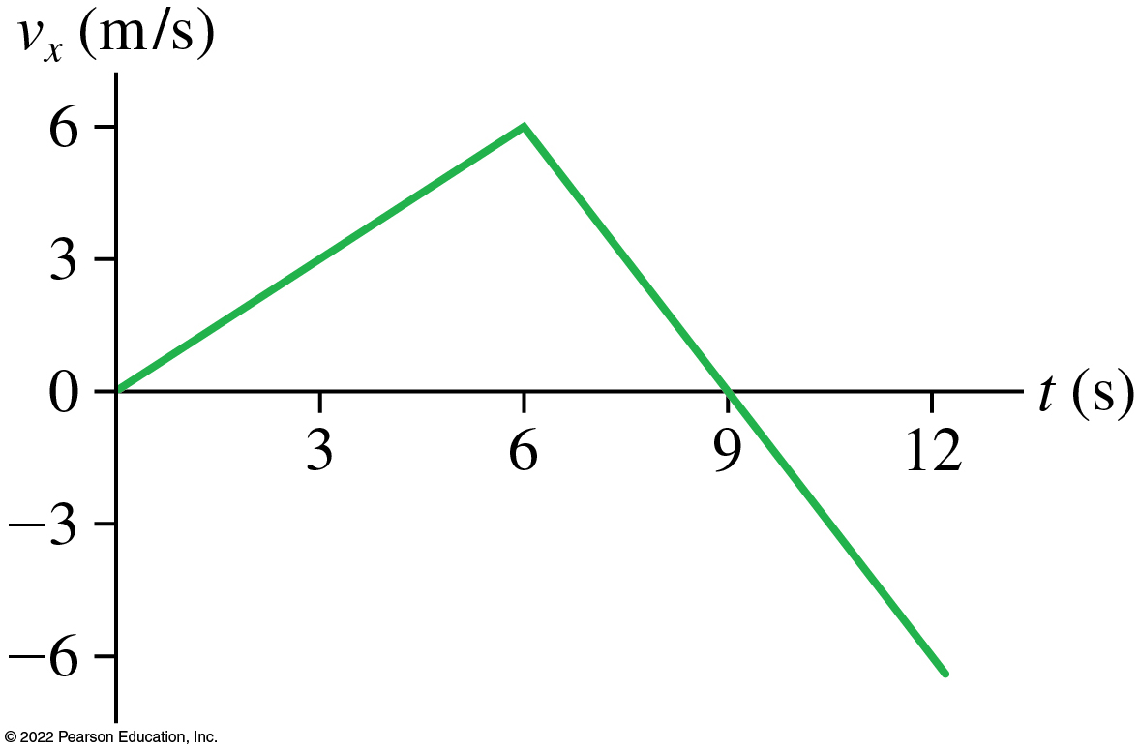
Graphs
X-axis (time) is independent variable (the thing you determined/controlled)
Y-axis (velocity) is the dependent variable (what you measured)
Label axes!
Include units!

Slide 6
Finding Roots
Linear: y = m x + b
  y = 0 implies x = - b / m
Quadratic: y = a x² + b x + c
  y = 0 implies x = (- b ± (b² – 4 a c)^{0.5} ) / 2 a
You can use these without proving it’s true. Consider it “common knowledge” for this course.
Note: the quadratic has two roots. You do need to explain which root is the correct one for a given problem!

Slide 7
Vectors versus Scalars
Scalars are numbers (like temperature).
Vectors are numbers AND directions.
I will mostly use N/S, E/W, up/down
  If you drop a rock, the direction it falls defines down
If a question asks you to find a vector quantity (like velocity instead of speed) you must include the direction for full credit!

Slide 8
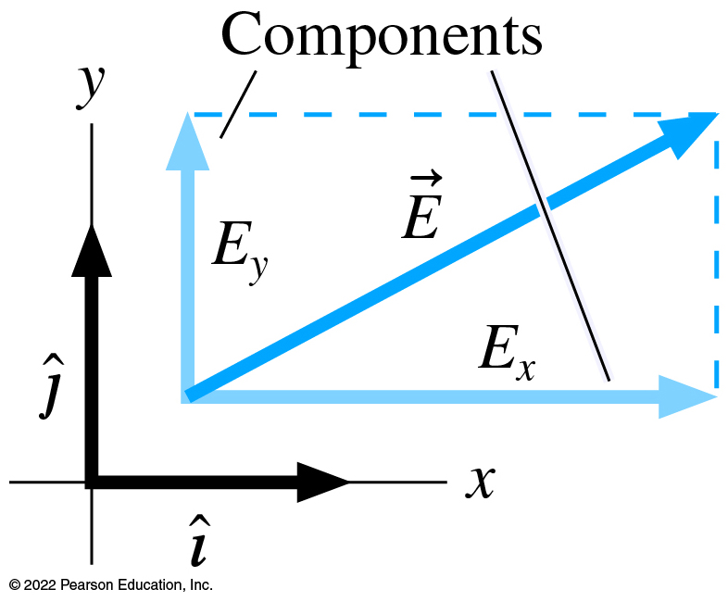
Coordinate Systems

Slide 9
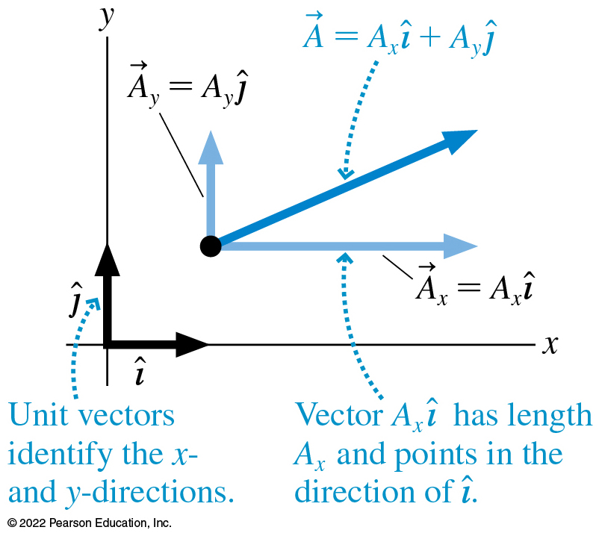
Coordinate Systems

Slide 10
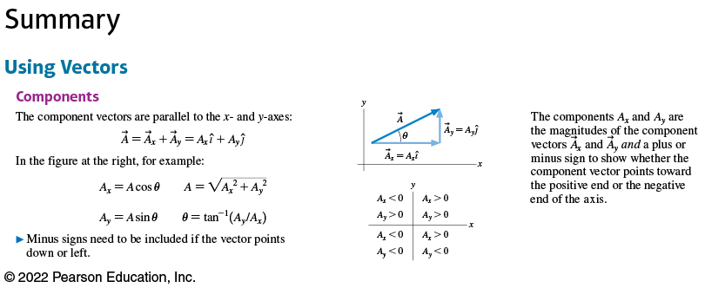
Coordinate Systems

Slide 11
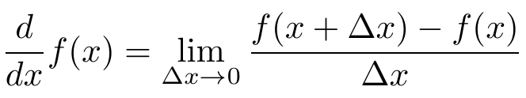




Derivatives

Slide 12
Integrals…?
Conceptually: the integral is the area under a curve (plus an arbitrary constant)
  It’s also an infinite sum of infinitesimal values
Mathematically: the integral is the inverse operator of the derivative
  If G(x) is the integral of F(x), then G’(x) = F(x)
  Sometimes called the anti-derivative
Since a v(t) graph is the slope of an x(t) graph, the area under the v(t) graph must be the original x(t) graph (plus a constant)

